Slide 1

TEAM DECENDERS
HOME AUTOMATION USING UNITY
TEAM MEMBERS
DHANUSH M
GIRIDHARAN V
PONMITHRESH B
VASANTHASUDAR M
MENTOR:
Mr. SATHISH KANNAN

Slide 2
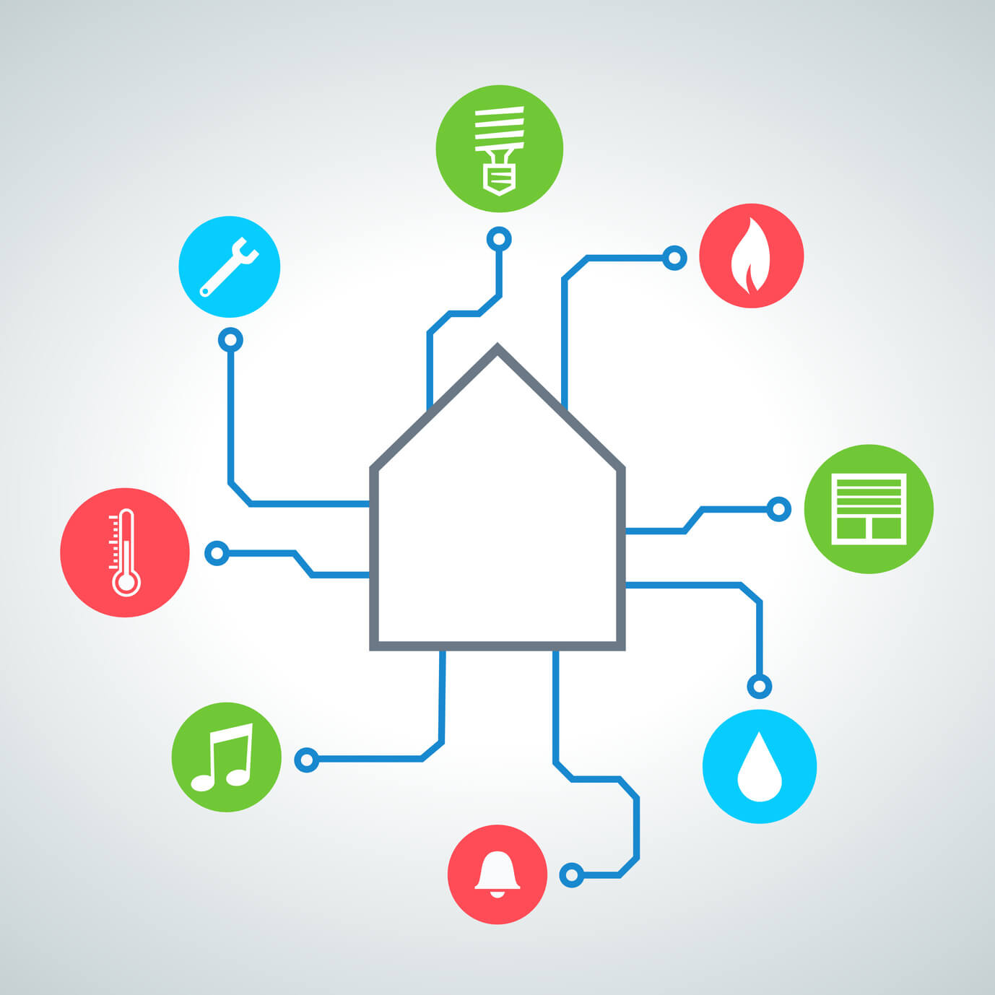
HOME AUTOMATION
Home automation is building automation for a home, called a smart home or smart house. A home automation system will monitor and/or control home attributes such as lighting, climate, entertainment systems, and appliances. It may also include home security such as access control and alarm systems. When connected with the Internet, home devices are an important constituent of the Internet of Things

Slide 3
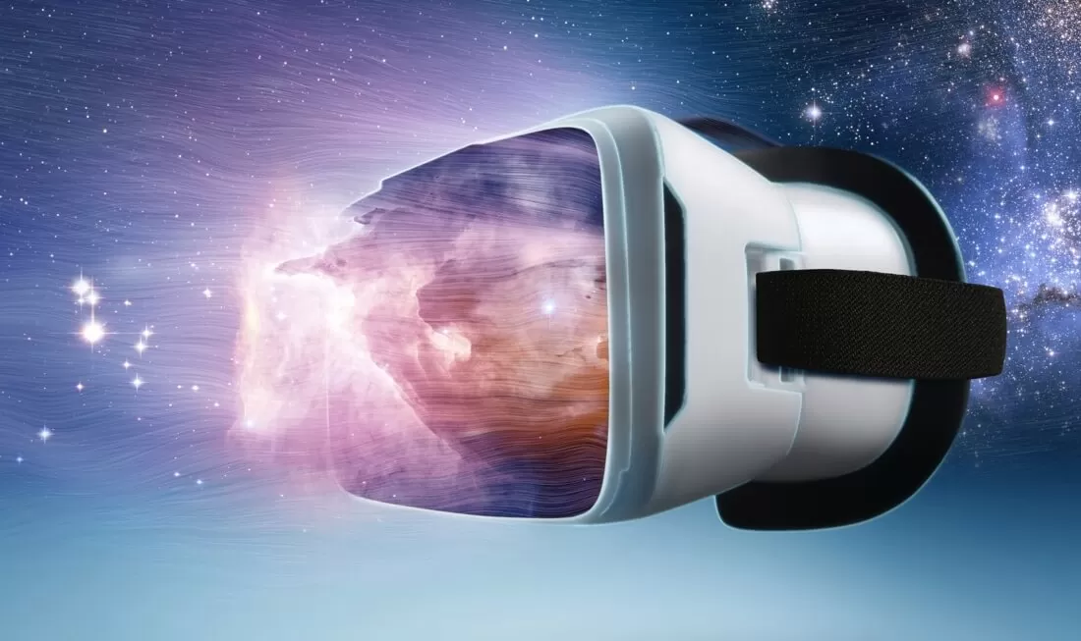
AR-VR
AR can be defined as a system that fulfills three basic features: a combination of real and virtual worlds, real-time interaction, and accurate 3D registration of virtual and real objects.
Virtual reality (VR) is a simulated experience that can be similar to or completely different from the real world. Applications of virtual reality include entertainment (e.g. video games) and education (e.g. medical or military training).

Slide 4
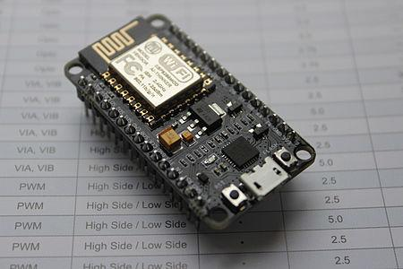
NODE MCU
Home automation refers to the ability of your home to make its own decisions depending on environment conditions and give you the option to control it from a remote location. The ESP8266 WiFi Module, we examined how NodeMCU or any of the other ESP8266 based boards can be used to build a web server through which all the GPIOs of the board can be controlled over WiFi.
Notes:
The heart of today’s project is the WiFi enabled board that needs no introduction. This Node Mcu board will help us to connect our devices to the cloud through wifi. Which had been used in our project too

Slide 5
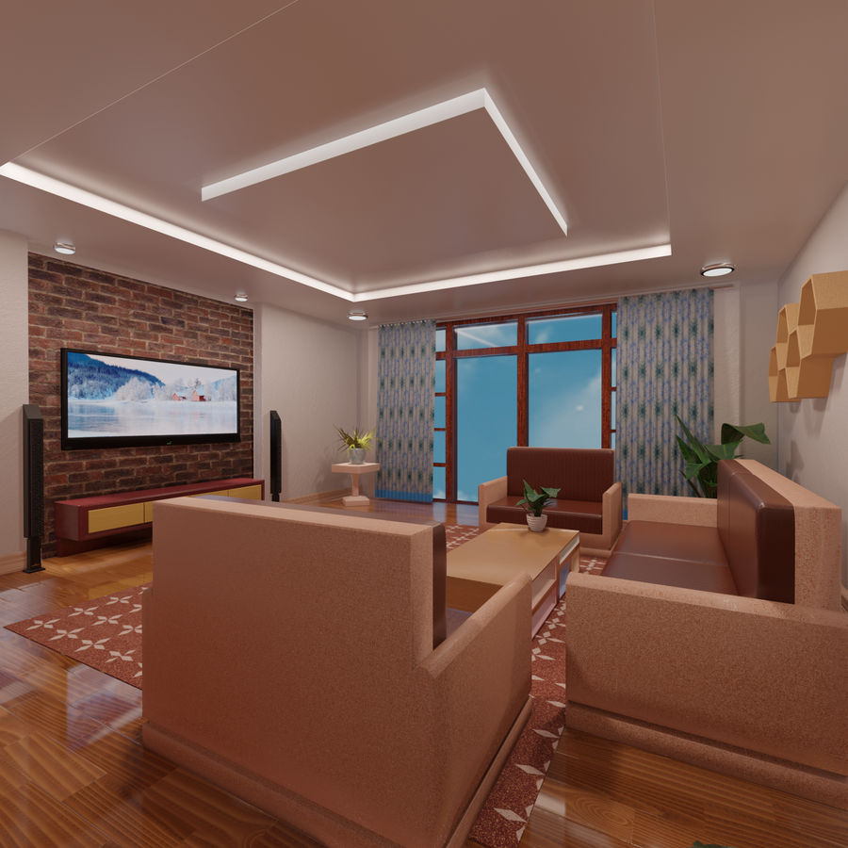
AR VR
The home model developed using AR technology will resembles our real home in which home automation is going to implemented.
Simple toggle button is enough to automate our home but for more devices in a room, it is hard to find switch for corresponding devices.
Hence AR technology will help us to overcome the above drawback and saves our time.
Notes:
In our project AR game developed using blender game Engine will act as user interface instead of toggle button used in webpages and apps.

Slide 6
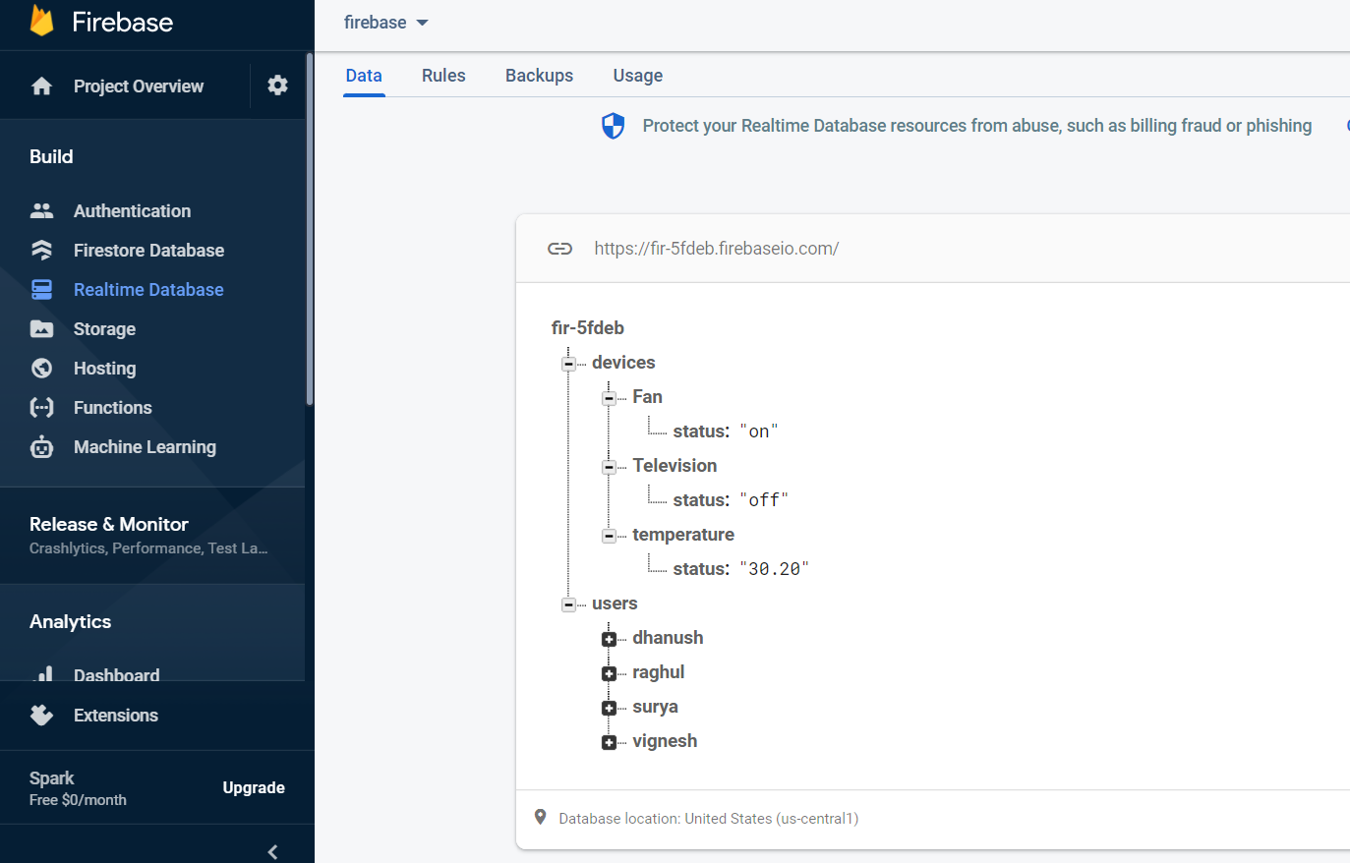
FIREBASE
Firebase is connected to unity using an asset called Rest client for unity which helps to store and retrieve.
The datas are stored and retrieved in a JSON format.

Slide 7

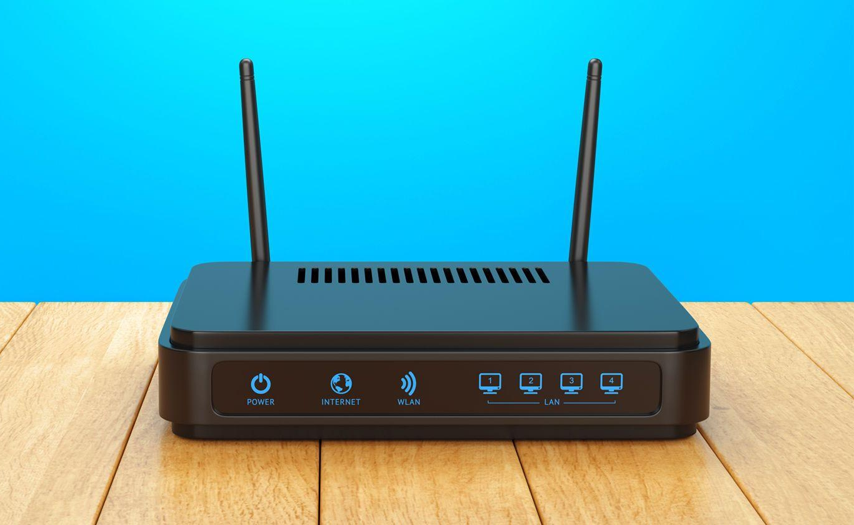
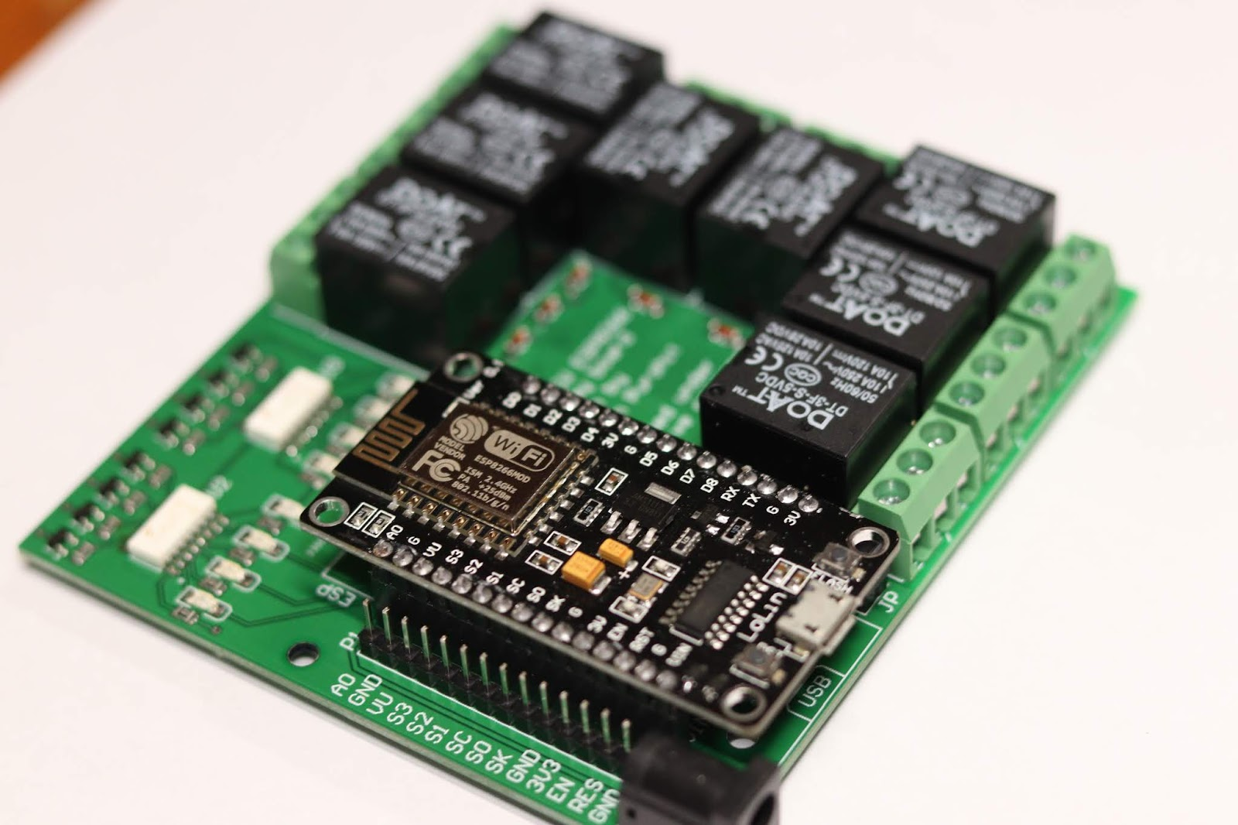
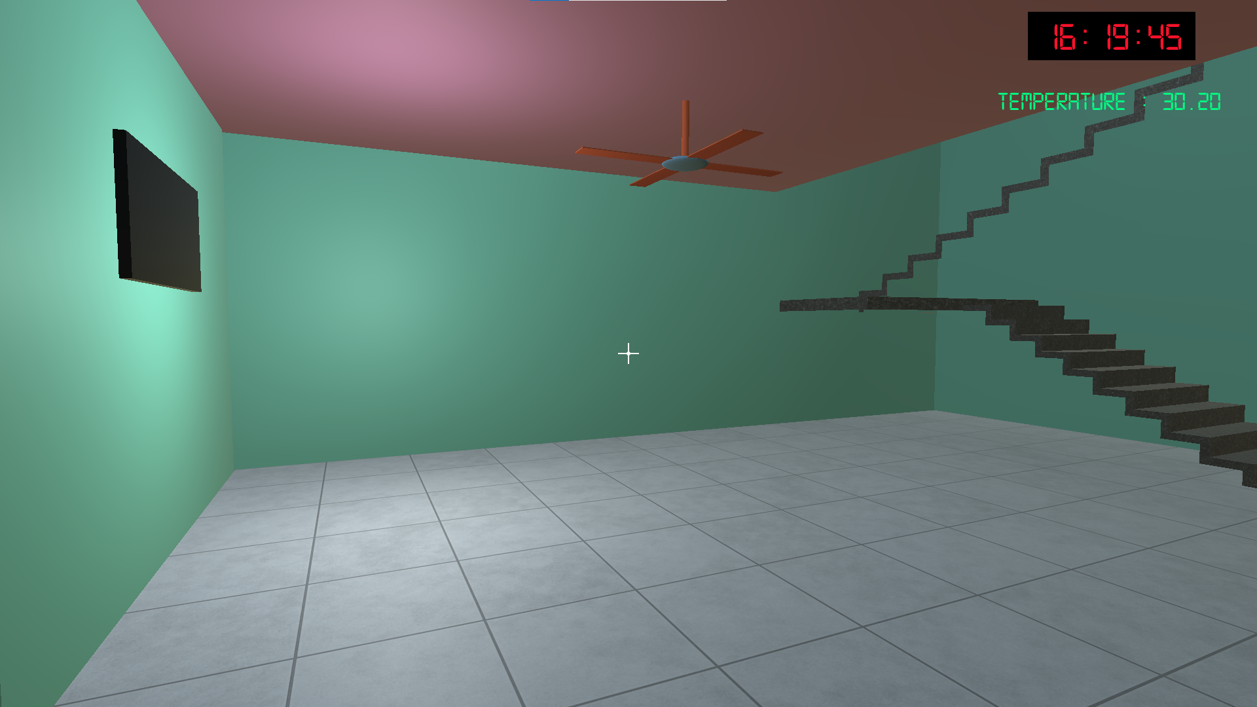
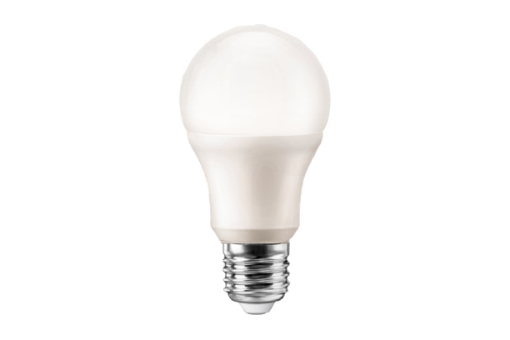
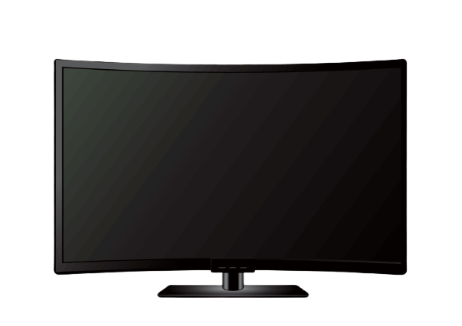
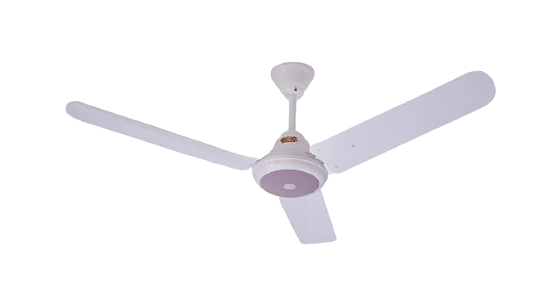
Working Flow
Firebase Realtime Database
Hardware
User interface
Home devices
Notes:
By clicking left mouse button upon the devices in the model will update string “on” to the server and the node MCU turn on the corresponding device which is clicked on our user interface. For example if the fan is clicked it will turn on the fan in the home at the same time animation of rotating fan will start play in the user interface which indicating that fan is “on” at the home. Similarly right mouse button will update string “Off” to the server in order to turn off the device at the same time animation stops playing.

Slide 8


